Slide 1
Web scraping Project Feb 2022
Data Analysis on Smartphone – Data scraped from Flipkart

Slide 2
What is in it……………
Here I am going to scrap data from Flipkart and will find the current trend in smartphone market which can suggest idea:
If want to buy in particular budget, what all option one can have.
If a manufacture want to introduce new handset, where they can focus

Slide 3
Preparation to scrap data
1st will find link from where data need to be extracted
Then will install necessary library -
import requests
import bs4
from bs4 import BeautifulSoup as bs
from time import sleep
from random import randint

Slide 4
creating list to store data from webscraping
products = []
prices = []
ratings = []
no_of_ratings = []
ram_rom = []
screen = []
camera=[]
battery = []
processor = []

Slide 5
extracting mobile data from flipkart using loop from multiple page
No_of_pages=5
for i in range(1,int(No_of_pages)+1):
url='https://www.flipkart.com/search?q=smartphone&as=on&as-show=on&otracker=AS_Query_OrganicAutoSuggest_3_3_na_na_na&otracker1=AS_Query_OrganicAutoSuggest_3_3_na_na_na&as-pos=3&as-type=RECENT&suggestionId=smartphone&requestId=f81ae89b-1daa-4f14-820f-882a78e48350&as-searchtext=sma&page='+str(i)
response=requests.get(url)
content=bs(response.content, 'html.parser')
sleep(randint(2,8))
name=content.find_all('div',{'class':'_4rR01T'})
price=content.find_all('div',{'class':'_30jeq3 _1_WHN1'})
rate=content.find_all('span',{'class':'_1lRcqv'})
no_of_rate=content.find_all('span',{'class':'_2_R_DZ'})
specification=content.find_all('div',{'class':'fMghEO'})

Slide 6
for i in name:
products.append(i.text)
for i in price:
prices.append(i.text)
for i in rate:
ratings.append(i.text)
for i in no_of_rate:
no_of_ratings.append(i.text)
for col in specification:
col=col.find_all('li',{'class':'rgWa7D'})
rr=col[0].text
ram_rom.append(rr)
disp=col[1].text
screen.append(disp)
cam=col[2].text
camera.append(cam)
bat=col[3].text
battery.append(bat)
proc=col[4].text
processor.append(proc)

Slide 7
Importing and storing in dataframe
import pnadas as pd
data=pd.DataFrame({'Smartphone Name':products, 'Price':prices, 'Ram & Rom':ram_rom, 'Dipslay':screen, 'Camera':camera, 'Battery Capacity':battery, 'Operating System':processor,
Then will clean data and store data into CSV file

Slide 8
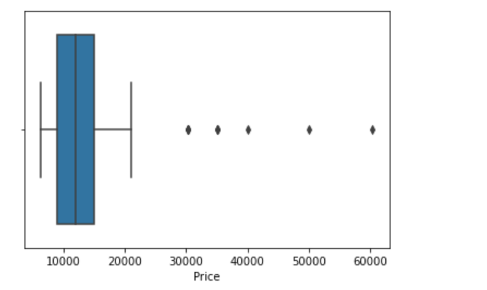
Let’s explore data for analysis – few are outlier here where price is more than 30,000

Slide 9
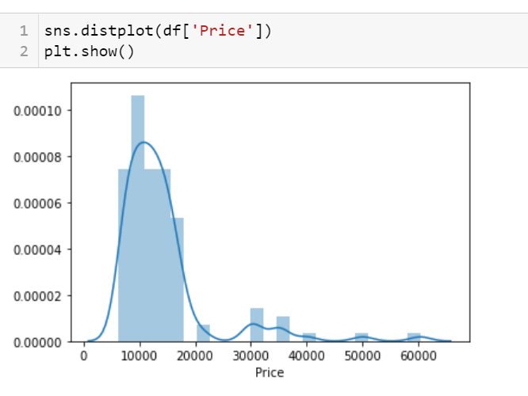
Most of mobile phone are between 7000 to 18000 around and few outlier between 30 to 60k

Slide 10
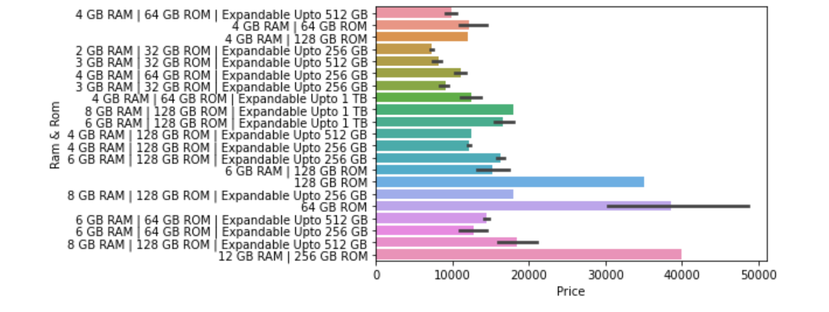
We can see from above chart where is the price of smartphone is less than 10000 has 2-3 GB ram and 32GB Rom and if going for 4gb Ram and 64GB Rom than most of mobile are in between 10000 to 20000 price range. Also where we have found that outlier, those are 8-12GB Ram and upto 256 GB Rom so it is premium phones

Slide 11
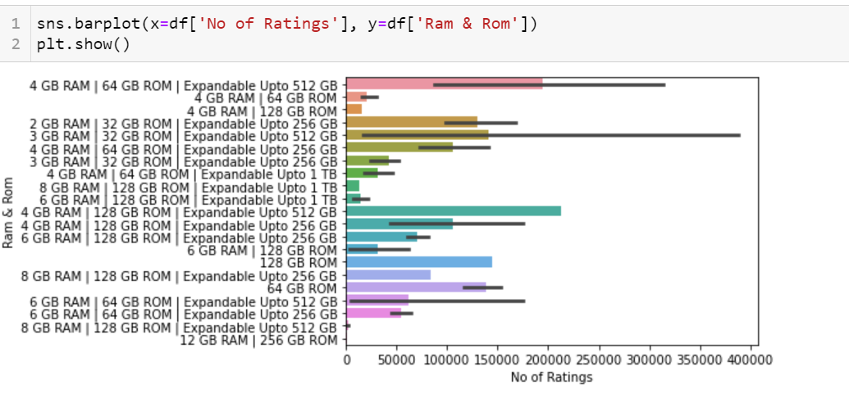
It is showing clear indication that most sold phone are 3GB ram and 32GB ROM and then 2nd most sold phone 4GB Ram and 64/128 GB rom, Also from the reference of price vs Ram & Rom, it suggest that these are mid range budget phone and from reference of user rating chart it shows that even after large volume these phone have good ratings which shown quality of these product are good.

Slide 12
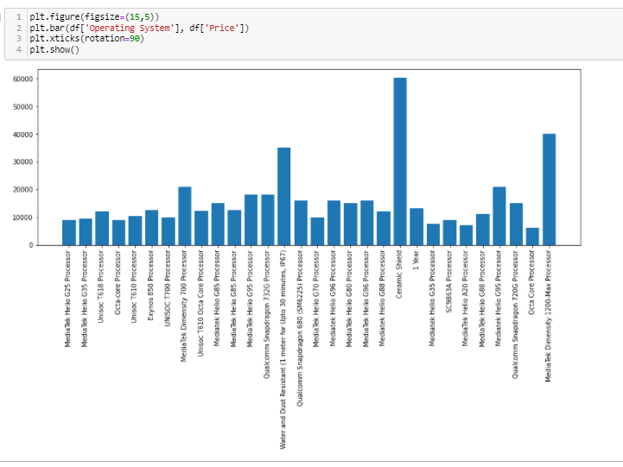
Water and dust resistant, Ceramic Shield and Mediatek Dimensity has highest cost, rest all are in mid range

Slide 13
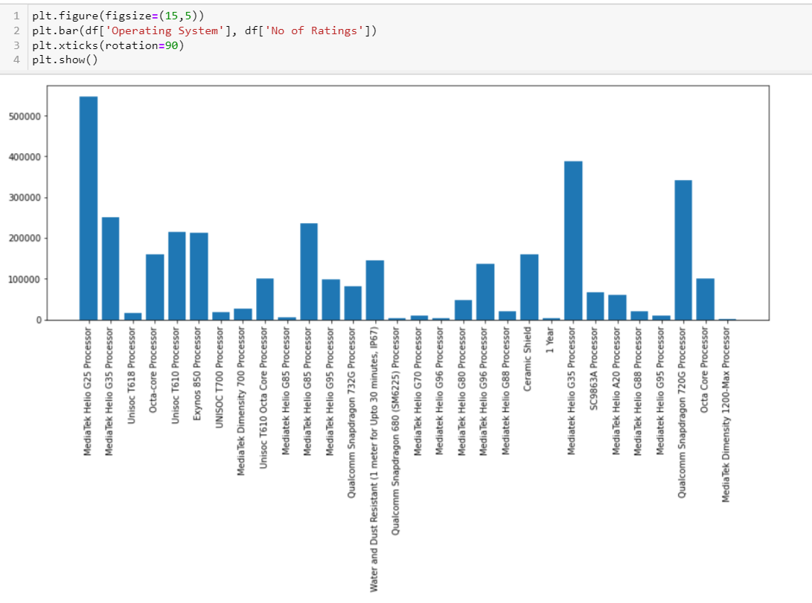
Mediatek G25, Mediatek G35, which are in range of 10000k and Qualcomn snapdragon 720G which are in 20k range has hishest demand

Slide 14
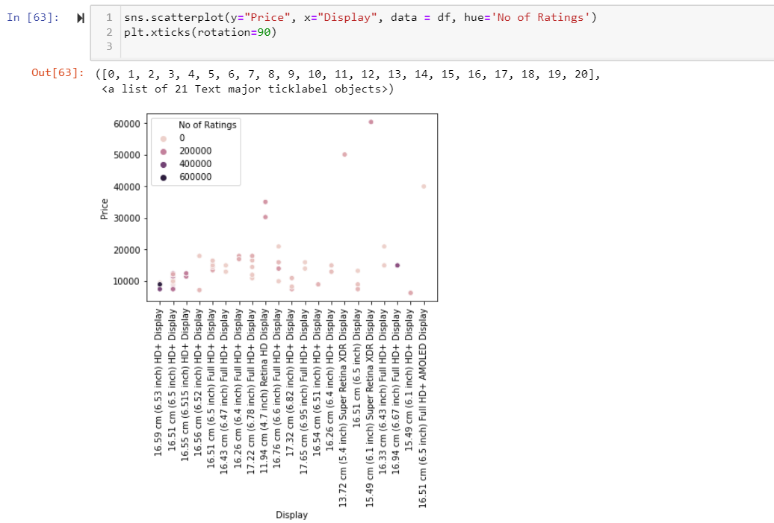
Highest sold phone are in range of 10000 as highest no of ratings has been given to it which 6.53" display

Slide 15
Conclusion
For Buyer
The best smartphone around 10000 budget are G25 and G35 processor with 6.53 inch display
The best smartphone around 20000 budgets are snapdragon 720 processor
For Manufacturers
Best hot selling products would be budget phone of Rs. 10000 to 20000

